Slide 1

Position Control Fiscal Year End

Slide 2
Before Getting Started…
Task | Responsibility
Create Pay Schedules | DBAS
Create Pay Names | DBAS
Roll Bonus Codes | TSB
Roll Account Strings | TSB
Roll Deduction Schedules | TSB
Link Deduction Schedules | TSB
These tasks will be completed on April 20th.
If you wish to begin the Position Control FYE process earlier, please submit a service request.

Slide 3
Position Control FYE Overview
Step | Task | Location | Responsibility | Page
1 | Work Calendars | HR Code Maintenance | District | 8-3
2 | Benefit Definitions | HR Code Maintenance | District | 8-15
3 | Salary Schedules | HR Code Maintenance. 2 | District | 8-23
4 | Authorized Position/ Employee Assignment Rollover Window | Position Control Job Menu | District | 8-39
5 | Recalculate Employee Position Projection Values | HR Report/ Job Selector Menu | District | 8-54
6 | Calculate Salary/Update Employee Positions | (Global) Job Menu | District | 8-61
7 | Load Payline Data from Position Control | HR Report/Job Selector | District | 8-83
8 | Update Employee Experience | HR Report/Job Selector | District | 8-93

Slide 4
Term Clarification
“Y1” and “Y2” will be used throughout this document.
Code | Description | Fiscal Year
Y1 | Current Fiscal Year | 2018-2019
Y2 | Next Fiscal Year | 2019-2020

Slide 5
Step 1: Work Calendars
Located in HR Code Maintenance.
Change Fiscal Year to Y2.
Create Work Calendar “0000.” (This is required.)
    Calendar should contain all paid holidays in organization.
Use calendar “0000” as a template to create other Work Calendars.
All Work Calendars should be created before moving to next step.

Slide 6
Step 2: Benefit Definitions
This Benefit Definitions can be copied from prior Fiscal Year.
The Benefit Projected Rate (BPR) Master File is located in the HR Code Maintenance menu.

Slide 7
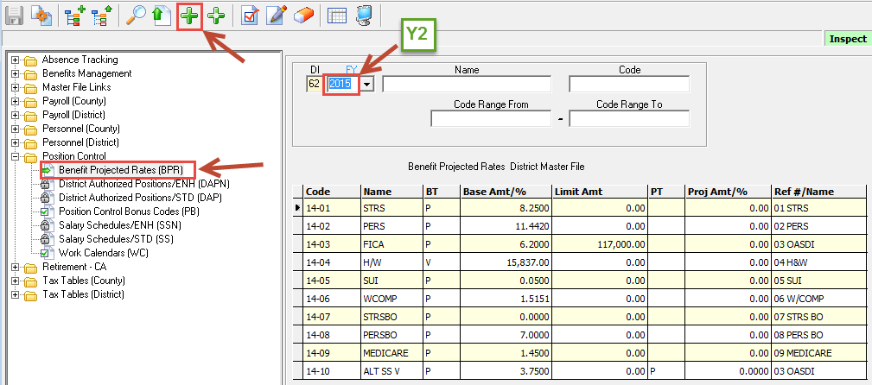
Step 2: Benefit Definitions
To copy, the prior year Benefit Definitions:
  Click Benefit Projection Rates
  Change Fiscal Year to Y2
  Click Add New.

Slide 8
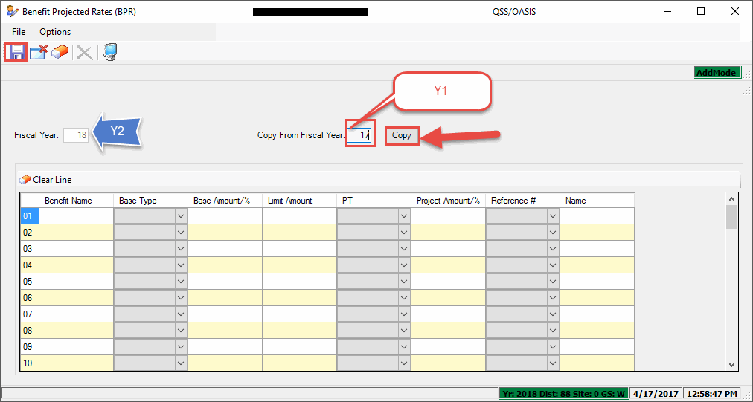
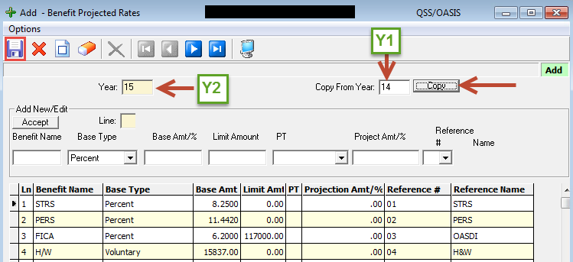
Step 2: Benefit Definitions
Enter Y1 in the Copy From field.
Click Copy.

Slide 9
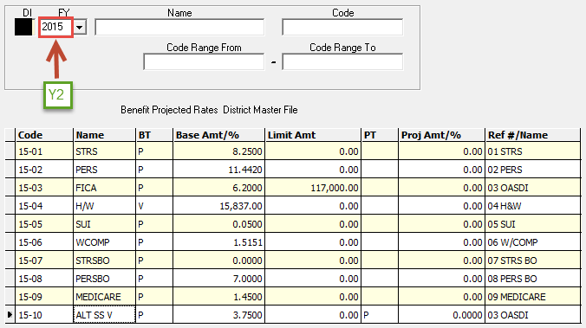
Step 2: Benefit Definitions (cont.)
Important to remember:
  Do not replace a benefit on a line with a new benefit.
  Do not delete an existing benefit in the new year definition simply because it is no longer offered.
    Instead, change the base amount to 0.00% or $0.00.

Slide 10
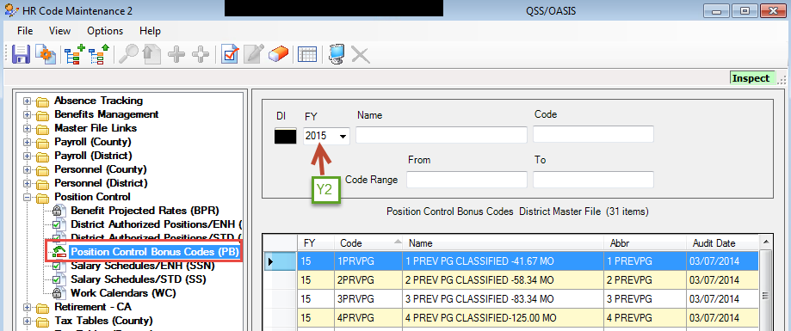
Step 3: Salary Schedules
Before coping salary schedules:
  Verify PB Bonus Codes in new Fiscal Year.
Contact TSB if PB Bonus Codes have not been rolled.

Slide 11
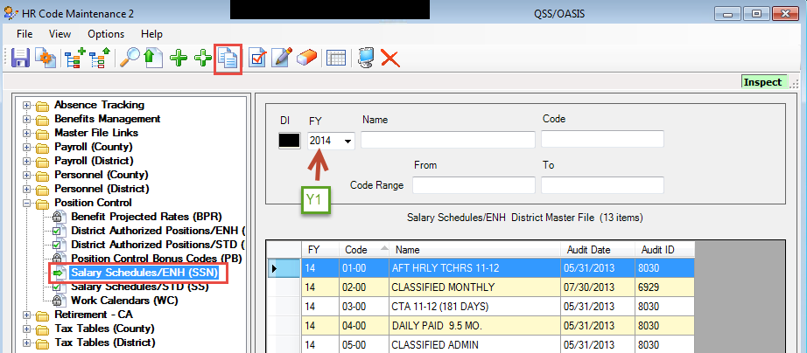
Step 3: Salary Schedules (cont.)
Located in HR Code Maintenance 2
Copy Salary Schedule

Slide 12
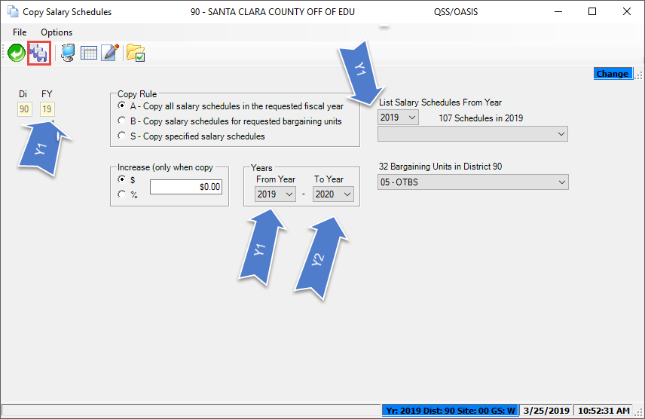
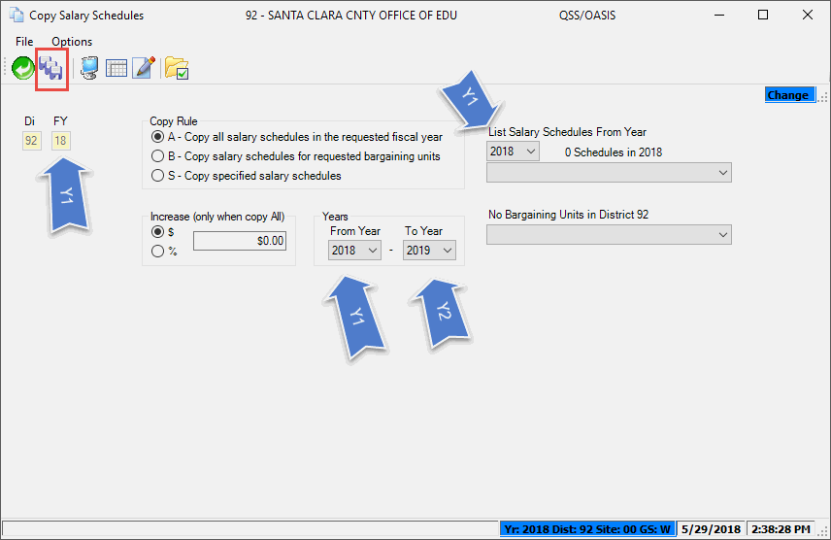
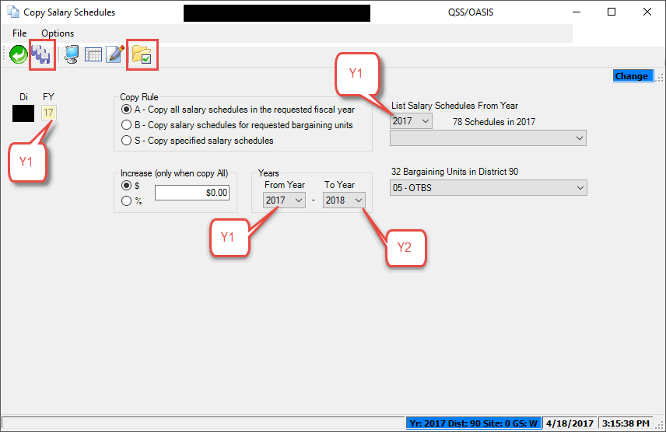
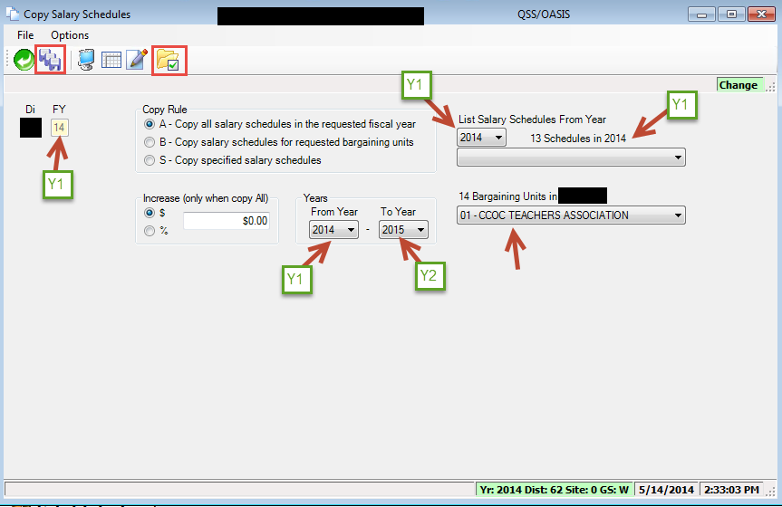
Step 3: Salary Schedules (cont.)
Select a Copy Rule (A, B, or S)
  Option A is recommended.
Click Verify Schedule and Model Data and Click Save.
Optional: Roll Salary Schedules for specific salary schedule only

Slide 13
Step 3: Salary Schedules
Assigning Default Benefits for Salary Schedules
Each Salary Schedule has a Benefits tab that you can use for assigning the default benefits to model 00.
After the Salary Schedules have been copied to Y2:
Verify the benefits are set up correctly for each Salary Schedule.

Slide 14
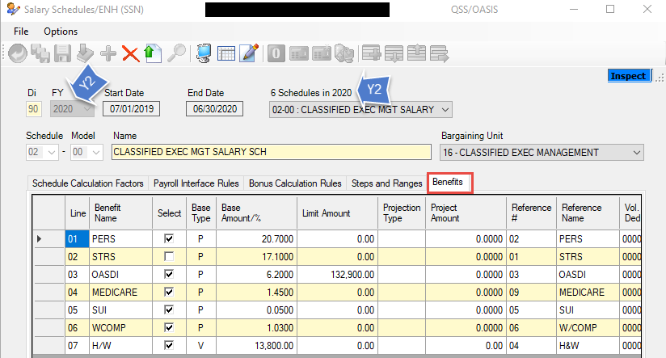
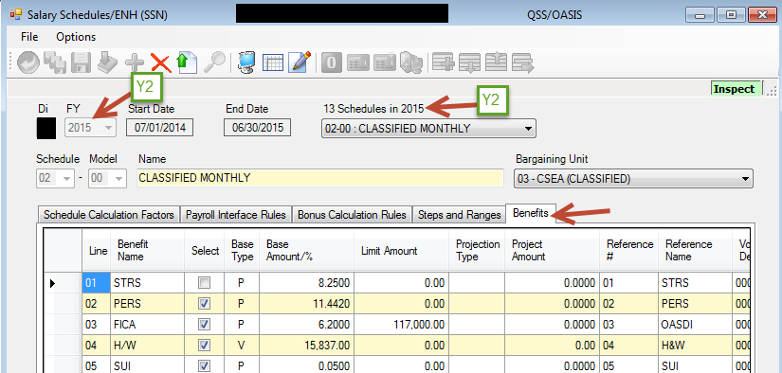
Step 3: Salary Schedules
Assigning Default Benefits for Salary Schedules
Log onto Y2.
Inspect Y2 Salary Schedules and quantity
Check Benefits Tab to ensure the employer-paid benefit are correct for each Salary Schedule.

Slide 15
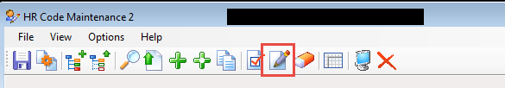
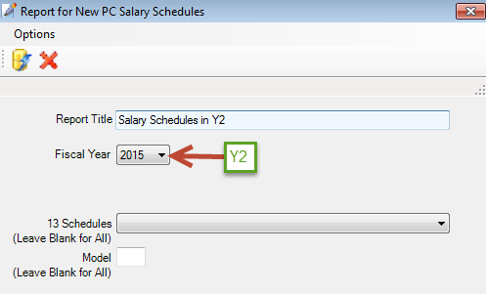
Step 3: Salary Schedules (cont.)
Run a Salary Schedule Report.
Save report for documentation purposes.

Slide 16
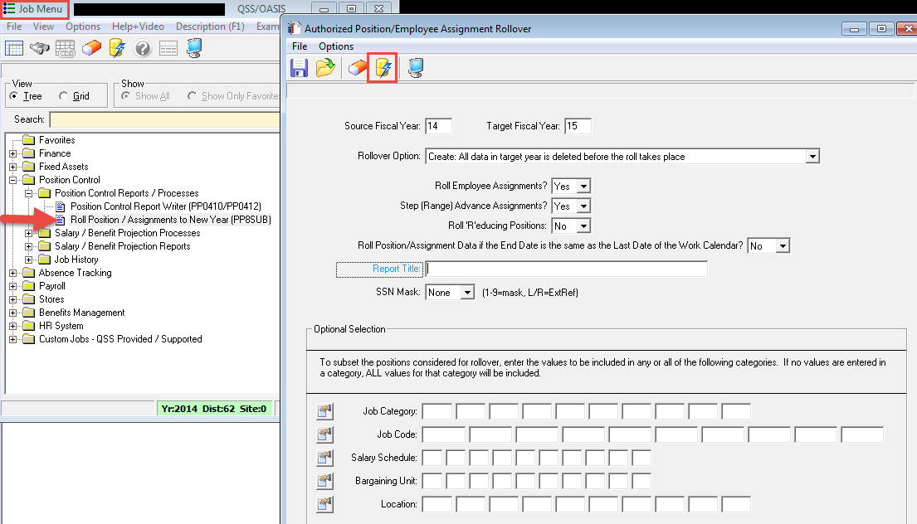
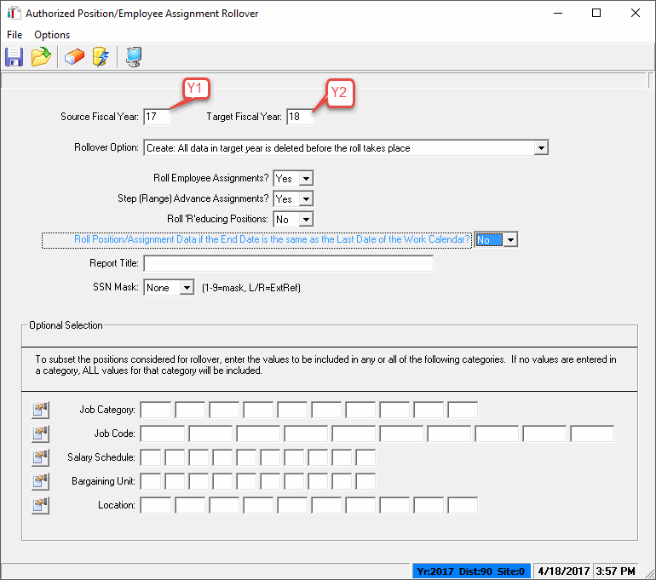
Step 4: Authorized Position/Employee Assignment Rollover Window
  Located in the Position Control Job Menu

Slide 17
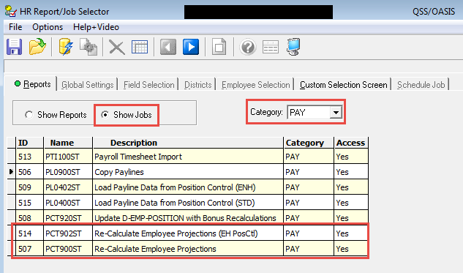
Step 5: Recalculate Employee Position Projection Values
  Located in the HR Report/Job Selector Menu
  Note: There are two jobs that recalculate employee projections
    PCT902ST – Used for Enhanced Position Control
    PCT900ST – Used for Standard Position Control

Slide 18
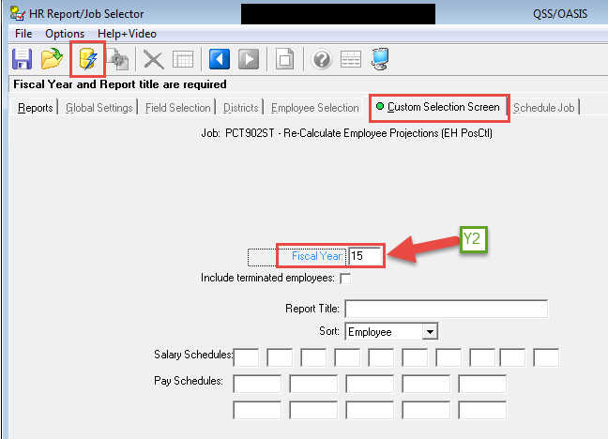
Step 5: Recalculate Employee Position Projection Values (cont.)

Slide 19
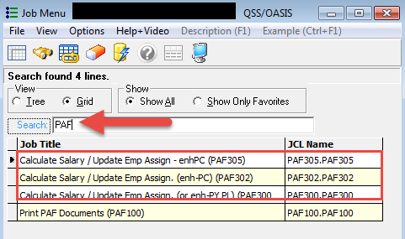
Step 6: Calculate Salary/
Update Employee Positions
Located in the (Global) Job Menu.
PAF305 is for districts using Enhanced Position Control and Enhanced Payroll
  PAF302 is for districts using Enhanced Position Control and Standard Payroll
  PAF300 is for districts using Standard Position Control and Standard Payroll
Hint: Select “Grid” and type “PAF” into “Search” box

Slide 20
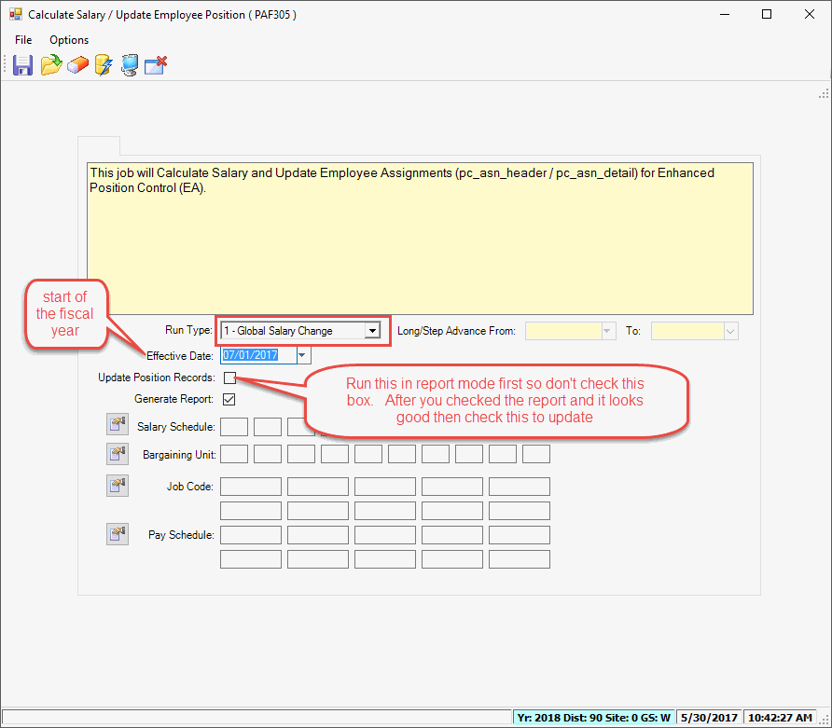
PAF305 Selection Screen

Slide 21
Step 6: Calculate Salary/
Update Employee Positions
Note: The PAF305 is used by districts using Enhanced Position Control and Enhanced Payroll. Most districts need to use this process.
Verify data between Step 1 and 2.
Verify data between Step 3 and 4
Report Criteria for PAF305
Step | Run Type | Generate Records | Update Position Records
1 | Global Salary | X
2 | Global Salary | X | X
3 | Long/Step Adv | X
4 | Long/Step Adv | X | X

Slide 22
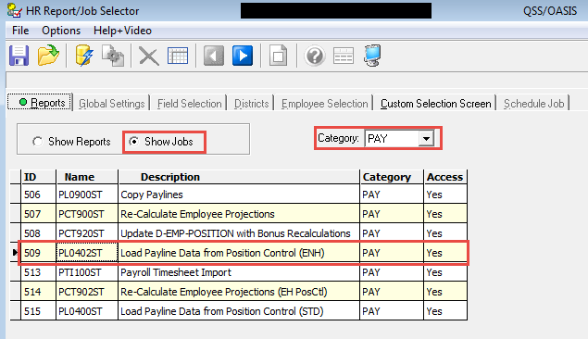
Step 7: Load Payline Data from Position Control
HR Report/Job Selector
This step is only to be completed by districts that use Position Control to drive Payroll

Slide 23
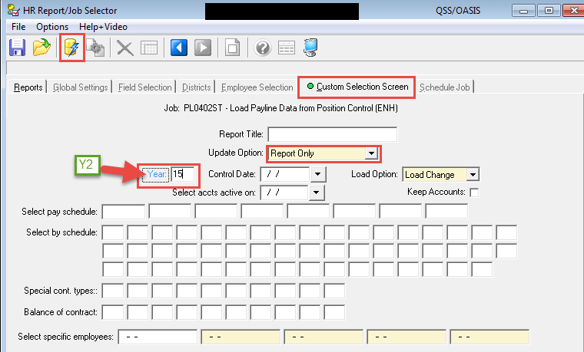
Step 7: Load Payline Data from Position Control (cont.)
Run in Report Only
Verify data
Run in Update and Report mode when ready
Change to Update and Report when ready.

Slide 24
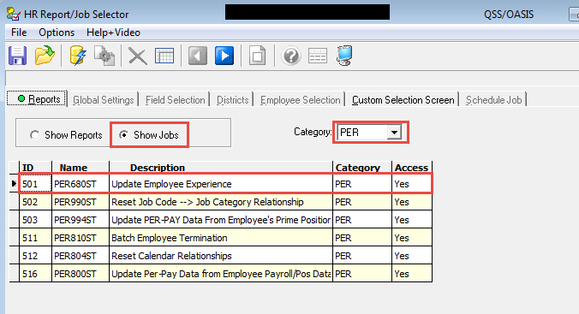
Step 8: Update Employee Experience
  Located in the HR Report/Job Selector
  Optional Step – Used to keep track of the years of experience an employee has within your district.
  Run only once a year to increment experience years by one.

Slide 25
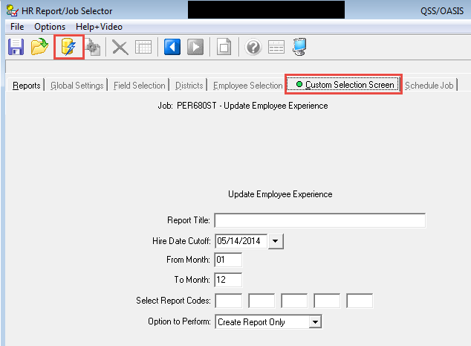
Step 8: Update Employee Experience (cont.)
Run in Create Report Only mode
Verify data
Run in Create Update and Report mode

Slide 26
Additional Steps – To Make Life Easier!
Step | Task | Location | Responsibility
1 | Update EC from Employee Prime | HR Report/ Job Selector | District
2 | Job History Load | (Global) Job Menu | District

Slide 27
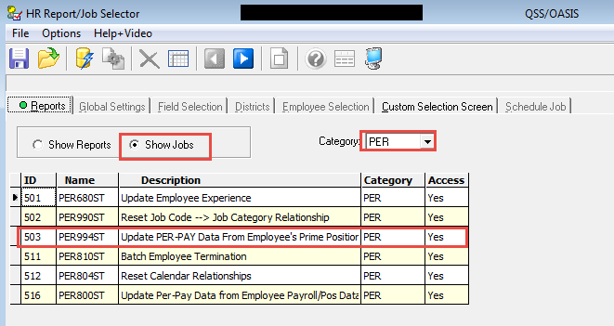
Additional Step 1: Update PER-PAY Data from Employee’s Prime Position
Located in HR Report/Job Selector

Slide 28
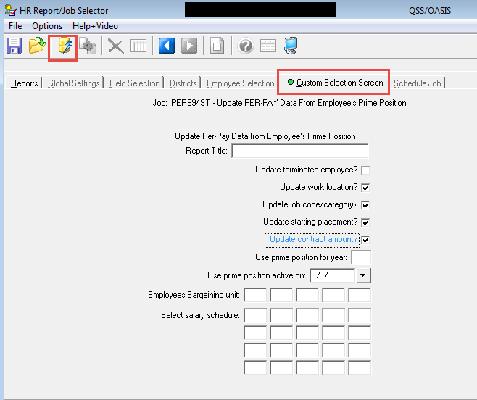
Additional Step 1: Update PER-PAY Data from Employee’s Prime Position (cont.)

Slide 29
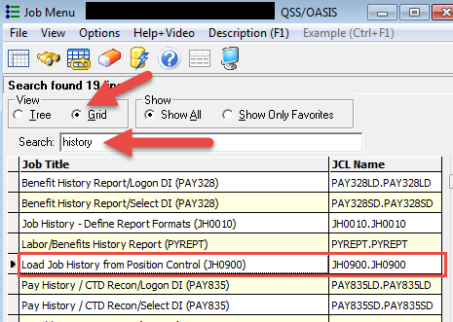
Additional Step 2: Load Job History from Position Control
Located in (Global) Job Menu

Slide 30
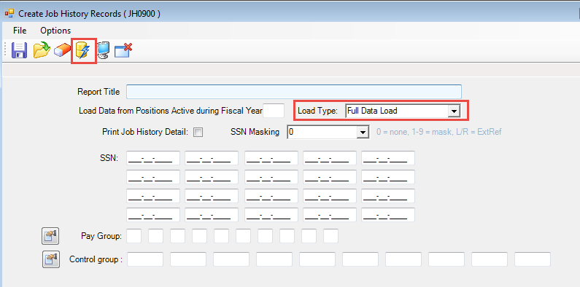
Additional Step 2: Load Job History from Position Control (cont.)
Use Load Type = Full Date at the beginning of FY
Use Load Type = Merge during the FY

